Slide 1
Ready to grow
next year?
BEAN THERE DONE THAT · ADVICE TO THE CEO
What one year of operational data tells us about running the roastery today, and what has to change before we grow.
[Names + student numbers] · Storytelling with Data · HAN Minor Data Driven Decision Making · October 2026
Notes:
Good morning. We are [names], and over the past weeks we acted as consultants for Bean there done that. In 2023 the company stopped taking on new customers to create a steady state. The CEO now asks one question: are we ready to grow as of next year? We analysed a full year of data on sourcing, roasting, stock, sales and delivery. Our short answer: not yet, but within one year, if you make three changes. Let us show you why.

Slide 2
Not ready to grow yet: three roadblocks, each with a fix that can be done within a year
OUR ANSWER UP FRONT
1 · CAPACITY IS FULL
2 · PLANNING IGNORES DEMAND
3 · SUPPLY AND SERVICE ARE FRAGILE
Both roasters and the packing line already use 8+ hours a day.
Flat roasting in a seasonal market: 48 t of coffee expired in 2023.
Beans for 7 days in July; 1 in 8 customers wrongly charged for shipping.
Fix: full batch loads and faster setups (+16%), then a 2nd shift in the peak season.
Fix: a monthly plan that roasts to the sales forecast, with a cap on stock.
Fix: bean safety stock, a 2nd farmer per origin, and a corrected webshop rule.
Bean there done that · company data 2023 · 2
Notes:
This is our whole story on one slide. Bean there done that is not ready to grow today, for three reasons. One: capacity is full. Both roasters and the packing line already run a complete shift. Two: production planning ignores demand. We roast the same amount every month in a seasonal market, so in 2023 48 tonnes of coffee expired. Three: supply and service are fragile. Bean stock fell to one week, and one in eight customers paid shipping costs they should not have paid. The good news: each roadblock has a fix that can be done within a year. The rest of the presentation shows the evidence.

Slide 3
A premium roaster that froze its customer base in 2023 to regain control
CRISP-DM 1 · BUSINESS UNDERSTANDING
±1,000 t green beans a year · <1% Dutch market share · specialty coffee at a premium price · mostly e-commerce, some B2B
Audience: the CEO. Question: can we start growing next year? Our job: measure each part of the operation, find roadblocks, advise.
Sourcing
Roasting
Packing & stock
Sales
Delivery
Days of beans in stock · expired beans
Hours used · throughput · QC rejects · yield
Packing hours · days of cover · expired coffee
Orders per day · kg per order · revenue
On-time rate · correct fees · shipping cost
Value chain of the company with the KPIs we measured per step → each step gets a score on the next slides
Source: company profile (case description) · 3
Notes:
We followed the CRISP-DM model and started with business understanding. Bean there done that roasts about 1,000 tonnes of green beans a year, has less than 1 percent of the Dutch market and sells premium specialty coffee, mostly online. After struggling with growth, the company stopped accepting new customers at the start of 2023. Our audience is the CEO, and the question is whether the company is ready to grow next year. To answer it we split the operation into five steps, from sourcing to delivery, and defined KPIs for each step. These are the KPIs you will see on the next slides.

Slide 4
The data is complete and consistent, except for packaging stock
CRISP-DM 2–3 · DATA UNDERSTANDING & PREPARATION
Dataset (2023) | Rows | What it tells us | Our check
E-com sales orders | 240,352 | 1 row per order: roast, bag, value, dates, fee | Complete, no missing values
B2B orders | 273 | 21 office clients, delivery every 4 weeks | Complete
Roasting | 36 | Batches, times and QC per machine, roast, month | Bean use matches stock: ✓
Finished goods stock | 36 | Stock and scrap per roast per month | Stock = roasted − sold − scrap: ✓
Raw material stock | 72 | Beans, bags, boxes: stock, purchases, scrap | Bags do not match sales: ✗
Preparation: bag type 1 = 1 kg and type 2 = 0.5 kg (derived from prices) · sales converted to kg · delivery promise = next working day. Data issue: stock records show ~15k half-kilo bags used per month while ~83k are sold, so packaging stock cannot be trusted.
Source: Bean there done that dataset, 5 sheets, Jan–Dec 2023 · analysis in Python (pandas, matplotlib) · 4
Notes:
Next, data understanding. We received five datasets covering 2023, including more than 240,000 webshop orders. Before drawing conclusions we checked whether the datasets agree with each other. They do: the beans used according to the stock records match the roaster input exactly, and finished-goods stock equals what was roasted minus what was sold and scrapped. That gives us confidence in the numbers. One exception: the packaging stock. The records show about 15,000 half-kilo bags used per month, while about 83,000 are sold. So packaging stock is not registered reliably, which is a risk in itself. In preparation we converted all sales to kilograms so we can compare sales with production.

Slide 5
Sales are stable, but four of five operations score red
CRISP-DM 4 · KPI SCORECARD 2023
Operation | KPI | 2023 | Status
Sourcing | Lowest green bean stock | 7 working days (July) | At risk
Sourcing | Green beans expired | 5.0 t | Watch
Roasting | Machine time used per day | P60 8.0 h · Px120 8.5 h | Full
Roasting | Batches rejected by QC | 1.9% (light roast 5.0%) | Watch
Roasting | Yield (roasted ÷ green) | 81% | OK
Packing & stock | Packing line time per day | 8.3 h | Full
Packing & stock | Roasted coffee expired | 48 t = 6.2% of output | Critical
Sales | Revenue (e-com + B2B) | €18.0M (97.7% e-com) | Stable
Sales | Orders per day | 658, flat all year | No growth
Delivery | Delivered next working day | 92.1% | Below promise
Delivery | Orders wrongly charged shipping | 30,725 orders · €152k | Critical
Delivery | Net shipping cost | €1.02M = 5.8% of e-com sales | Watch
Source: company data 2023, own calculations (definitions in appendix) · 5
Notes:
Here is the scorecard: the KPIs for each part of the operation. Sales are stable at 18 million euros, almost all of it online. But look at the status column: sourcing, roasting, packing and delivery all have at least one red KPI. Capacity is full, 48 tonnes of roasted coffee expired, bean stock got dangerously low, and the webshop charged more than 30,000 customers shipping costs by mistake. On the next slides we zoom in on each of these, one message per slide.

Slide 6
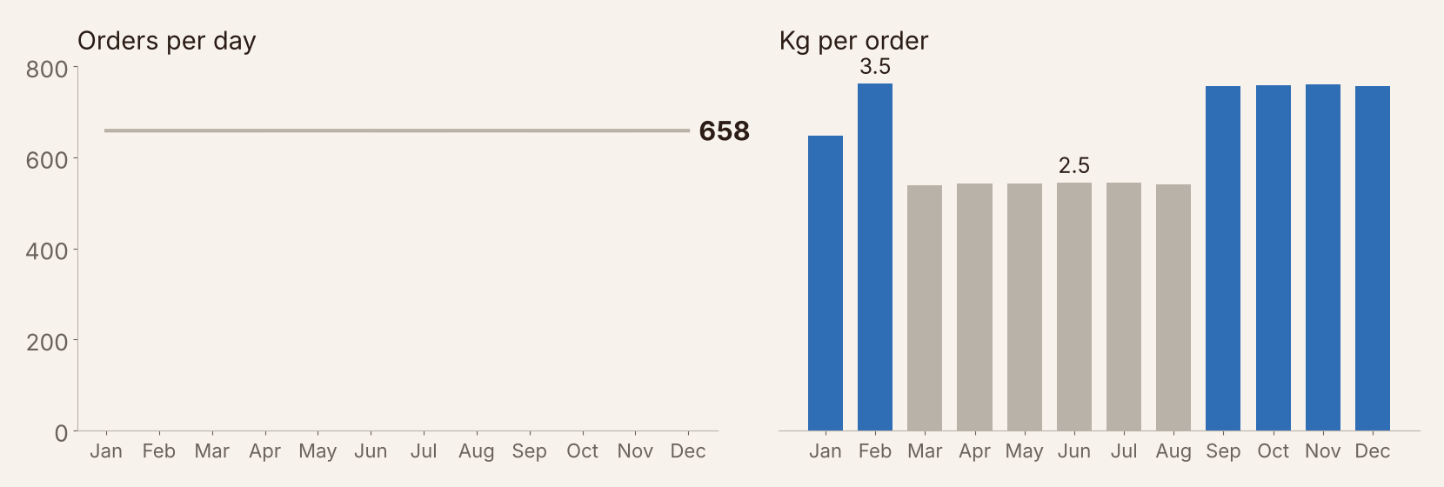
Orders are frozen at 658 a day; only basket size moves with the seasons
SALES
+36%
more coffee per order in Sep–Feb (3.4 kg) than in Mar–Aug (2.5 kg).
The number of orders never changes: the stop on new customers works. B2B is small: 21 office clients, 2.3% of revenue.
Source: 240,352 e-com orders and 273 B2B deliveries, 2023 · 6
Notes:
Let's start with sales, because demand drives everything else. On the left: the number of orders per day. It is exactly 658, every day of the year. That is the effect of the decision to stop accepting new customers. On the right: how much coffee each order contains. In the autumn and winter, September to February, customers buy about 3.4 kilos per order; in spring and summer about 2.5. That is 36 percent more. So demand is clearly seasonal. B2B is small: 21 office clients and only 2.3 percent of revenue. Remember this seasonal pattern, because the roastery does not follow it.

Slide 7
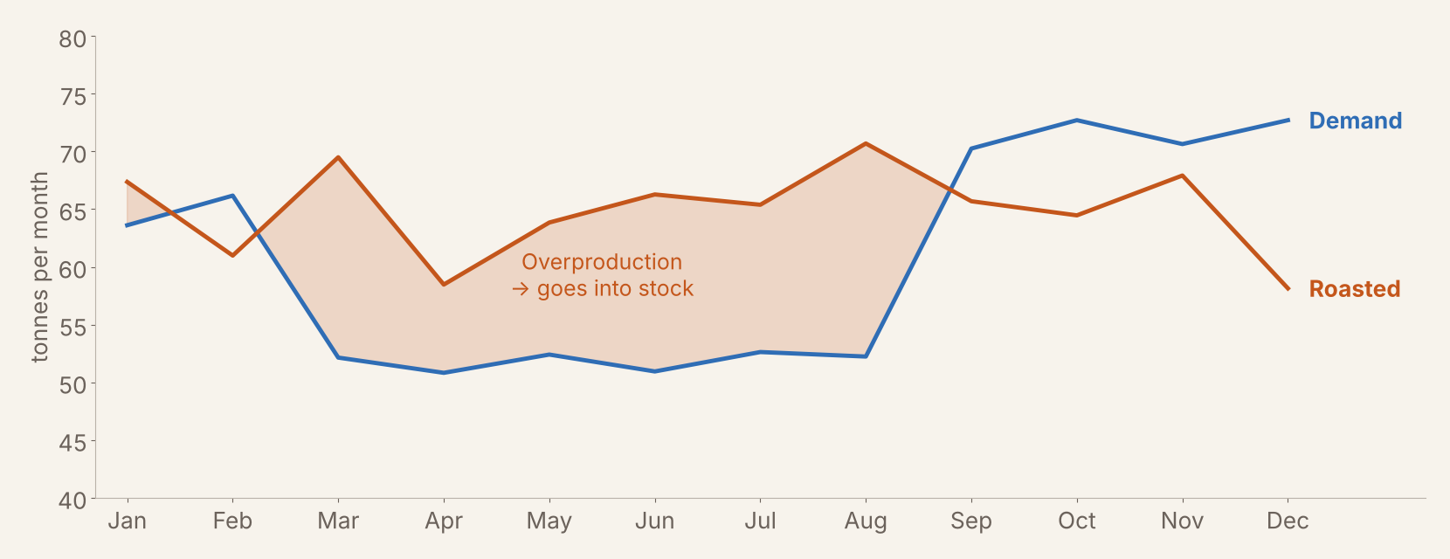
We roast about 65 t every month while demand swings between 51 and 73 t
ROASTING VS DEMAND
83 t
roasted on top of demand in March–August, all of it going into stock.
In September–December the roasters cannot keep up and the stock is drained by 30 t.
Source: roasting data (good batches × final weight) vs e-com + B2B sales in kg, 2023 · 7
Notes:
Now compare demand, the blue line, with what we roast, the orange line. Roasting is almost flat at about 65 tonnes per month. Demand is not: about 52 tonnes in spring and summer, about 72 in autumn and winter. So from March to August we roast 83 tonnes more than we sell, and it all goes into the warehouse. From September onwards it is the other way around: demand is higher than what the roasters can make, and we live off the stock. The production plan is not linked to the sales forecast. What happens to all that summer stock? Next slide.

Slide 8
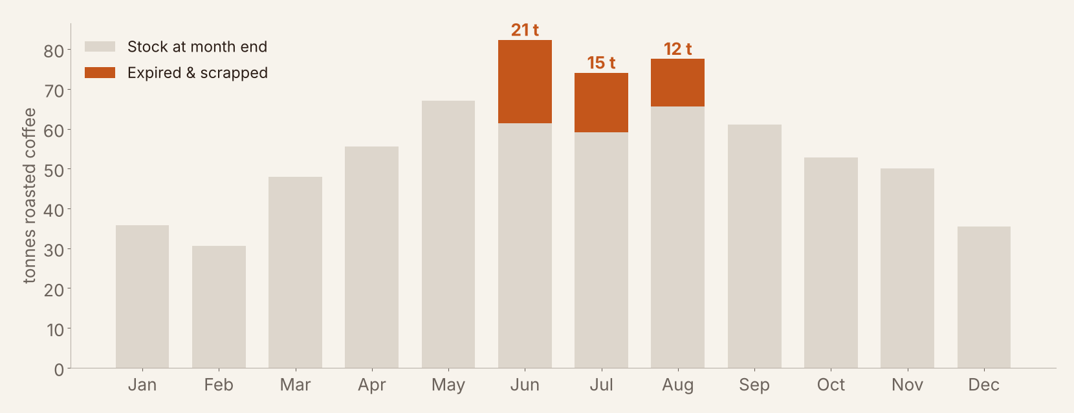
The summer overstock expired: 48 t of roasted coffee was thrown away
WAREHOUSE
6.2%
of everything we roasted expired: ≈ €0.5M in green beans, €1.16M in sales value.
Coffee expired in the months after stock passed ~6 weeks of sales (dark roast: 49 days in May).
Source: finished goods inventory 2023; bean cost = €8.32/kg green ÷ 81% yield = €10.33 per kg roasted · 8
Notes:
This is the cost of flat production. The grey bars show roasted coffee in the warehouse. From February to May stock more than doubles. Roasted coffee is a fresh product, and in June, July and August 48 tonnes expired and had to be scrapped, the orange parts. That is 6.2 percent of everything we roasted. In green beans alone that is about half a million euros; in sales value it is 1.16 million. The pattern is clear: coffee expired after stock rose above roughly six weeks of sales. This is the biggest improvement opportunity in the company, and it costs no investment, only better planning.

Slide 9
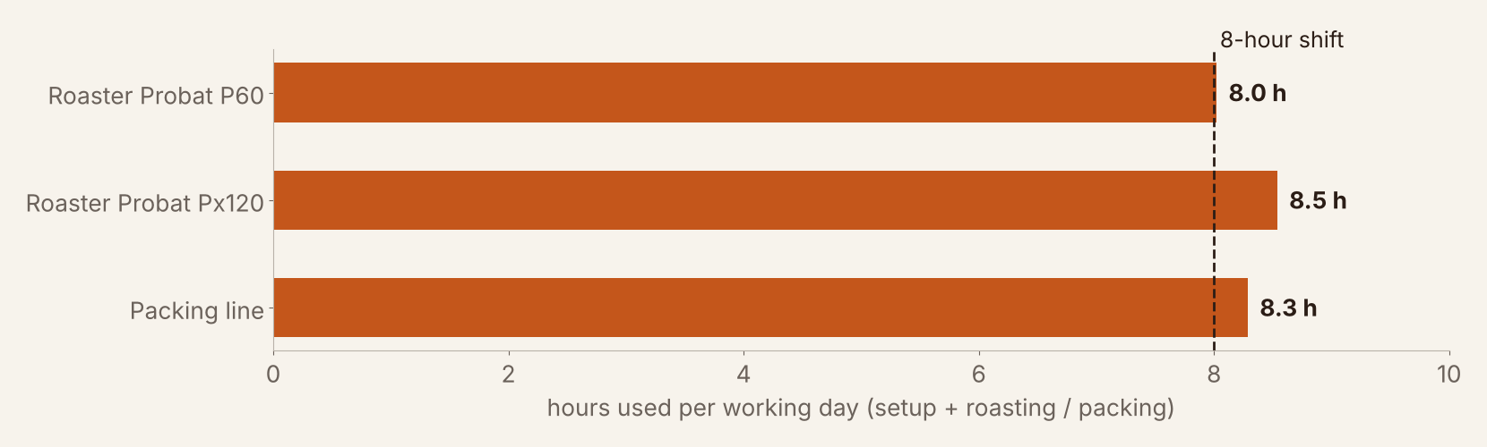
Roasters and packing line already run a full shift: no room to grow
ROASTING & PACKING CAPACITY
63%
of its rated 480 kg/h is what the Px120 really delivers (P60: 76% of 215 kg/h).
Why: batches filled to only 92% (110 of 120 kg) and setups of 6.0 min per batch vs 4.1 min on the P60.
Source: roasting data 2023; hours = batches per day × (setup + roast time); assumption: one 8-hour shift · 9
Notes:
Why can't the roasters follow demand in autumn? Because they are full. On a normal working day the P60 is busy for 8 hours, the Px120 for 8.5 hours, and the packing line for 8.3 hours. That is one complete shift, already slightly over. There is hidden capacity though. The Px120 is rated at 480 kilos per hour, but in practice delivers only 63 percent of that. Two reasons: batches are filled to 110 instead of 120 kilos, and every setup takes 6 minutes, versus 4 on the smaller roaster. Those are the quick wins we will come back to.

Slide 10
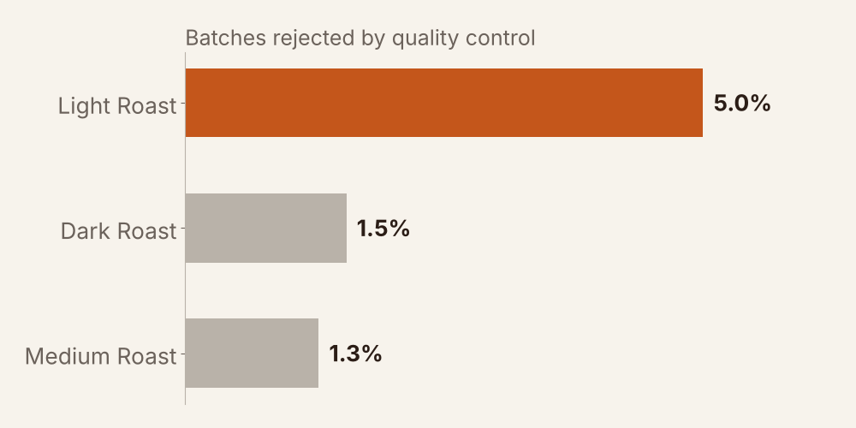
Light roast fails quality control three to four times as often as the other roasts
ROASTING QUALITY
83
light roast batches of 1,672 rejected in 2023, more than dark and medium although we roast far less of it.
Rejects are spread evenly over weight, colour and roast profile, so it is a process issue, not one fault. Light and dark share the Px120 (2.5% rejects vs 1.3% on the P60): switching roast profiles is the likely cause.
Source: roasting data 2023, QC rejects ÷ batches roasted · 10
Notes:
Quality is generally good: fewer than 2 percent of batches are rejected. But light roast is the exception: 5 percent of its batches fail, three to four times as often as dark or medium. The reasons are spread evenly over weight, colour and roast profile, so there is not one broken thing. What stands out is that light and dark roast share the same machine, the Px120, and switch profiles every day. That machine has twice the reject rate of the P60, which only roasts medium. Every rejected batch costs beans and, now that we are at full capacity, also scarce machine time.

Slide 11
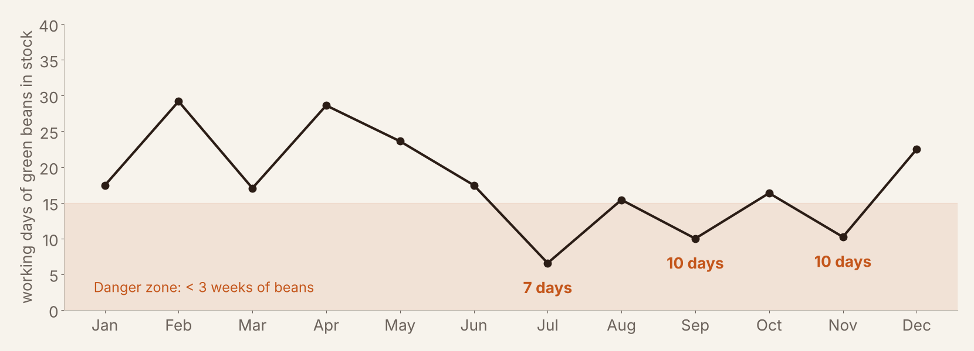
Bean stock fell to 7 working days in July: one late container stops the roasters
SOURCING
98
containers of green beans in 2023, each origin from a single farmer (direct trade).
Meanwhile 5 t of beans expired in May. Orders follow a fixed rhythm, not actual usage and shipping lead time.
Source: raw material inventory and roasting data 2023; 1 container = 12 pallets × 12 bags × 70 kg = 10,080 kg · 11
Notes:
Now the start of the chain: the green beans. Here you see how many working days of roasting the bean stock covers at the end of each month. Three times it dropped below three weeks, and in July to only 7 working days. The beans come by sea container from Colombia, Uganda and Costa Rica, so one delayed ship would stop the roasters. At the same time, 5 tonnes of beans expired in May. That tells us purchasing follows a fixed rhythm instead of actual usage. In 2023 we bought 98 containers, and each origin comes from one single farmer. For growth that is a real roadblock: one farmer cannot simply double his supply.

Slide 12
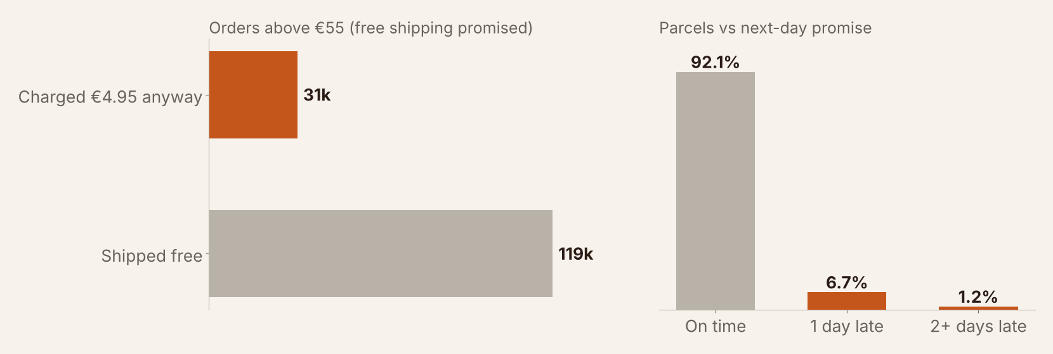
1 in 8 customers paid shipping they should not have, and 1 in 13 parcels is late
DELIVERY & WEBSHOP
€152k
overcharged in 2023. The webshop gives free shipping from 5 bags, not from €55.
So every order of 3–4 one-kilo bags (€69–106) pays €4.95. Late parcels are spread evenly over provinces and weekdays: a PostNL process issue.
Source: 240,352 e-com orders 2023; promise = next working day (weekends and Dutch public holidays excluded) · 12
Notes:
At the end of the chain, the customer. Two problems. First, the shipping fee. The promise is free shipping above 55 euros. But the webshop actually applies a different rule: free shipping from five bags. So a customer who buys three or four one-kilo bags, worth 69 to 106 euros, still pays 4.95. That happened more than 30,000 times, one in eight orders, 152 thousand euros in total. Second, delivery. We promise next-day delivery, but 7.9 percent of parcels arrive later, about one in thirteen. Lateness is spread evenly over all provinces and weekdays, so it is a process issue at PostNL, not a regional one. For a premium brand both problems hurt customer trust.

Slide 13
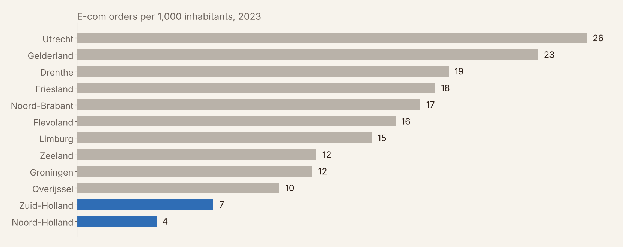
Growth is within reach: Noord- and Zuid-Holland buy 4–6× less per inhabitant than Utrecht
GROWTH OPPORTUNITY
+22%
more orders if the two biggest provinces only reach the Dutch average of 13.5 per 1,000.
All 21 B2B clients are offices in the Randstad already, so the own delivery truck drives there anyway.
Source: e-com orders 2023; population per province CBS, 1 January 2023 (rounded) · 13
Notes:
So what if the company starts growing next year? First, where would growth come from? We compared orders with the number of inhabitants per province. Utrecht and Gelderland order a lot. But Noord-Holland and Zuid-Holland, the two biggest provinces, order 4 to 6 times less per inhabitant. If those two only reached the Dutch average, we would have 22 percent more orders, without opening any new region. And our B2B clients are already in the Randstad. So 20 percent growth next year is realistic. That brings us to the key question: can the operation handle it?

Slide 14
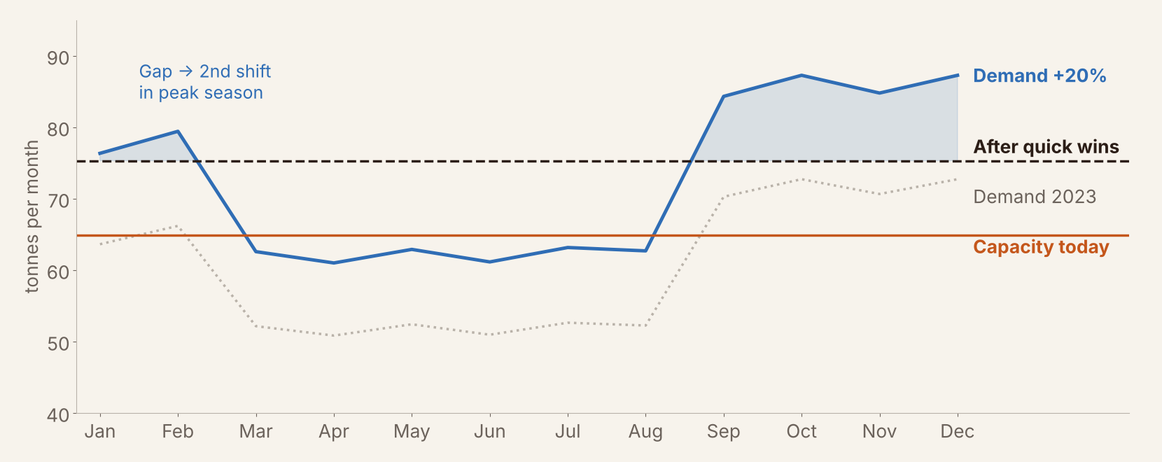
With 20% growth, demand exceeds capacity in 6 of 12 months, even after quick wins
SCENARIO: +20% DEMAND NEXT YEAR
12 t
per month short in Oct and Dec after quick wins: a 2nd shift is needed in the peak season.
Also +20%: ~118 containers of beans, ~790 parcels a day, and 20% more bags and boxes to plan.
Source: 2023 demand × 1.2 with the same seasonal pattern; capacity = average roasted output 2023; quick wins = full batches + Px120 setup at P60 level (+16%) · 14
Notes:
Here we simulate 20 percent growth with the same seasonal pattern, the blue line. The orange line is today's capacity: about 65 tonnes a month. With growth, demand is above that in six months of the year. The quick wins, full batches and faster setups on the Px120, lift capacity by 16 percent to about 75 tonnes, the dashed line. That covers spring and summer, but in the peak season we are still up to 12 tonnes a month short. And we cannot roast it in advance, because we just saw that stock expires. So the peak needs a second shift, on the roasters and the packing line. Everything else grows too: about 118 containers of beans, 790 parcels a day, and 20 percent more packaging.

Slide 15
Fix, prepare, then grow: a one-year roadmap
ADVICE TO THE CEO
1 · FIX NOW · months 1–3
2 · PREPARE · months 3–8
3 · GROW · from month 9
Set the webshop rule to free shipping above €55; compensate overcharged customers
Monthly sales & operations plan: roast to forecast, max ~4 weeks of stock, first-in-first-out
Register packaging stock correctly
Fill batches to 60/120 kg and cut Px120 setups to 4 min (+16% capacity)
Root-cause light-roast rejects on the Px120
Bean reorder point of 4+ weeks; add a second farmer per origin
Agree a next-day target of ≥97% with PostNL
Reopen to new customers, starting with Noord- and Zuid-Holland (e-com and offices)
Second shift on roasters and packing line in Sep–Feb
Assess a third roaster once growth passes ~30%
CRISP-DM 6 · Deployment · 15
Notes:
Our advice is a one-year roadmap in three phases. Phase one, fix now, in the first three months: correct the shipping rule in the webshop and compensate the customers who paid too much. Start a monthly sales and operations plan, so we roast to the sales forecast with a maximum of about four weeks of stock, first in, first out. And register packaging stock correctly. Phase two, prepare: get the quick wins on the roasters, solve the light-roast quality problem, build a bean safety stock and add a second farmer per origin, and agree a clear delivery target with PostNL. Phase three, grow: from month nine, just before the peak season, reopen to new customers, starting in Noord- and Zuid-Holland, and run a second shift in the busy months.

Slide 16
Yes, grow next year, but only after the fixes are in place
EXPECTED OUTCOME
€0.5M
+16%
+20%
in beans saved per year when no roasted coffee expires
roasting capacity without buying a new machine
growth absorbed, with a peak-season 2nd shift
Our request today: approve the 3-month fix plan and start preparing the peak-season shift, so the doors can reopen to new customers in month 9.
Estimates based on 2023 data · 16
Notes:
So, is Bean there done that ready to grow next year? Our answer is yes, but only after the fixes are in place. The expected outcome: about half a million euros a year saved on beans when no coffee expires; 16 percent more roasting capacity without buying a new machine; and room for 20 percent growth with a second shift in the peak season. Our request to you today: approve the three-month fix plan and start preparing the peak-season shift, so the company can reopen to new customers in month nine. Thank you, we are happy to answer your questions.

Slide 17
KPI definitions and assumptions
APPENDIX
Item | Definition / assumption
Roasted output | (batches per day × workdays − rejected batches) × final weight per batch
Demand in kg | e-com bags × bag size (type 1 = 1 kg, type 2 = 0.5 kg, derived from price) + B2B 1 kg bags
Machine hours per day | batches per day × (setup + roast time); cooling runs in parallel; one 8-hour shift assumed
Days of cover | stock ÷ average use per (working) day in that month
Value of expired coffee | bean cost €8.32/kg green (weighted purchases) ÷ 81% yield = €10.33/kg roasted
On time | delivered on the next working day after ordering (weekends + Dutch holidays excluded)
Quick wins (+16%) | P60 batches 54.9 → 60 kg; Px120 110 → 120 kg and setup 6.0 → 4.1 min; weighted by machine output
Growth scenario | 2023 monthly demand × 1.2, same seasonal pattern; capacity = average monthly output 2023
Analysis script: bean_there_analysis.py (Python, pandas, matplotlib) · 17
Notes:
Backup slide for questions about how we calculated the numbers.

